Slide 1
COMPUTER SCIENCE DEPARTMENT WEBSITE sscsportal.com
TO SHOW ALL INFORMATION OF COMPUTER SCIENCE DEPARTMENT OF SWAMI SUKHDEVANAND POSTGRADUATE COLLEGE (SHAHJAHANPUR)
Submitted by:
Saumya Verma
Dhruv Gupta
Gauri Singh Komal Singh
Harshit Singh

Slide 2
Table of contents
01
02
Introduction
Software & Hardware Requirement
03
04
Technologies used
Source Code
05
06
Website Interface
Conclusion

Slide 3
Introduction
Welcome to the presentation of the Computer Science Department Website for SSPG College Shahjahanpur. This project was undertaken to create a comprehensive, user-friendly, and informative online platform for our department. The primary goal was to enhance communication and resource accessibility for our students, faculty, and prospective students. The website features a modern design, intuitive navigation, and a wealth of information ranging from academic resources to faculty profiles, aiming to provide an enriching digital experience for all users..

Slide 4
Software & Hardware Requirement
Software Requirement
VS Code Editor (HTML, CSS, JS)
An updated web browser
PHP Xampp
My SQL latest version
Windows 11
Hardware Requirement
Lenevo i3 core processor
Desktop/Laptop with 8GB RAM or above.
Stable Internet Connection.
Harddisk (memory occupied 260Mb).

Slide 5



Technological Used:
HTML:-
HTML is the standard markup
language used for creating web page
provides the structure of the web content
by defining elements such as headings,
paragraphs, links, and images. For this
project, HTML was used to build the basic
structure of the web pages.
CSS:-
CSS is used to control the
presentation and layout of web
pages. By separating content
from design, CSS allows for
more flexible and maintainable
code. In this project, CSS was
utilized to style the HTML
elements, ensuring a visually
appealing
JAVASCRIPT:-
JavaScript is a versatile scripting language that enables dynamic content and interactive elements on web pages. For this project, JavaScript was implemented to add functionality such as print the student profile page.

Slide 6


PHP:-
PHP is a popular server-side scripting
language designed for web development. It
is embedded within HTML and is especially
suited for web-based applications. In this
project, PHP was used to handle server
side logic, including data processing and
interaction with the database.
MYSQL:-
MYSQL is a relational database
management system that uses SQL
(Structured Query Language) for database
access. It is widely used due to its
reliability, robustness, and ease of use. For
this project, MySQL was chosen to manage
and store the data for the Computer
Science Department.

Slide 7
Source Code

Slide 8
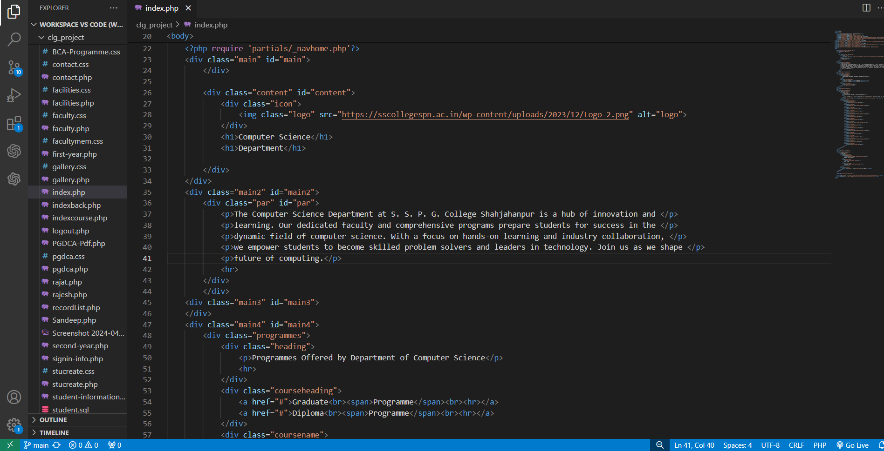
HTML code

Slide 9
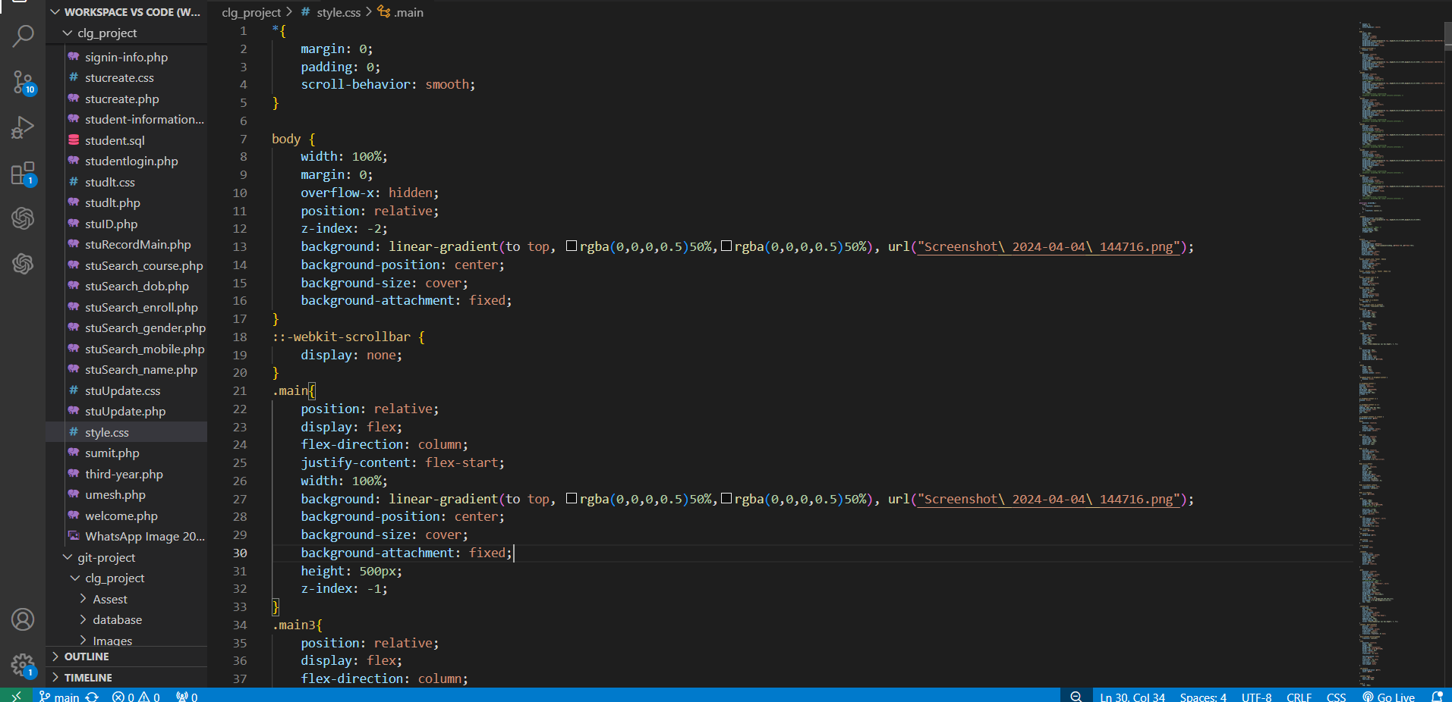
CSS code

Slide 10
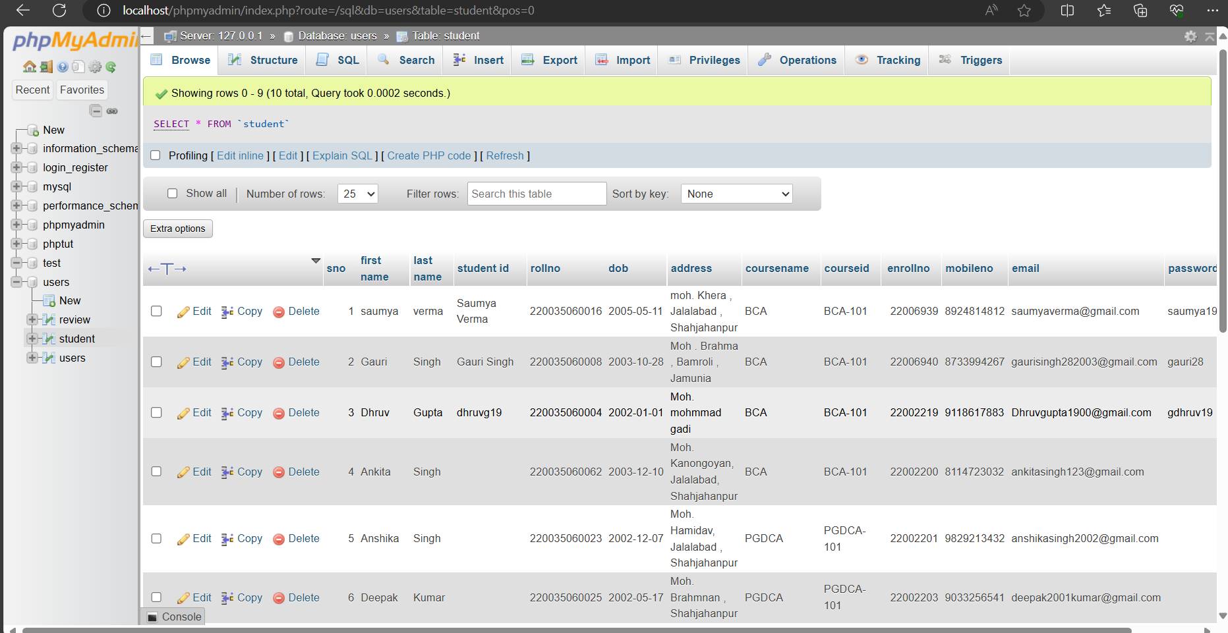
DataBase

Slide 11
Interface of Website

Slide 12
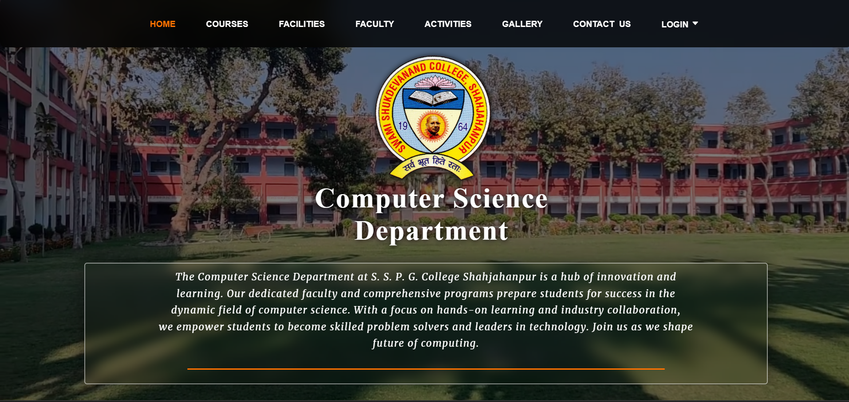
Home Page

Slide 13
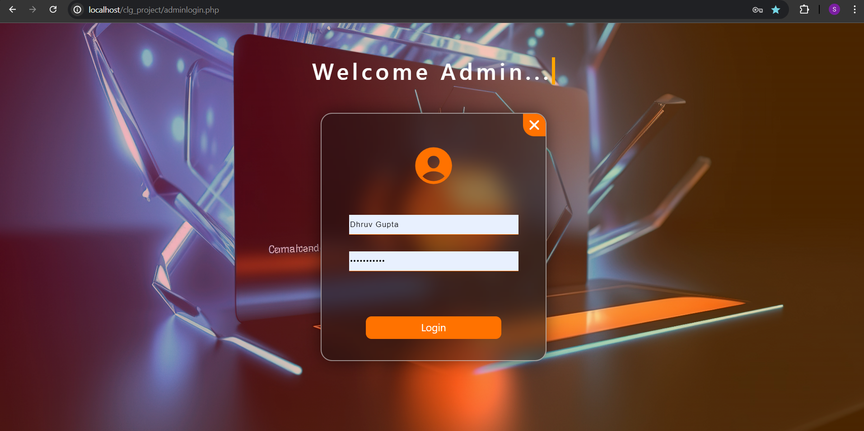
Admin Login Page

Slide 14
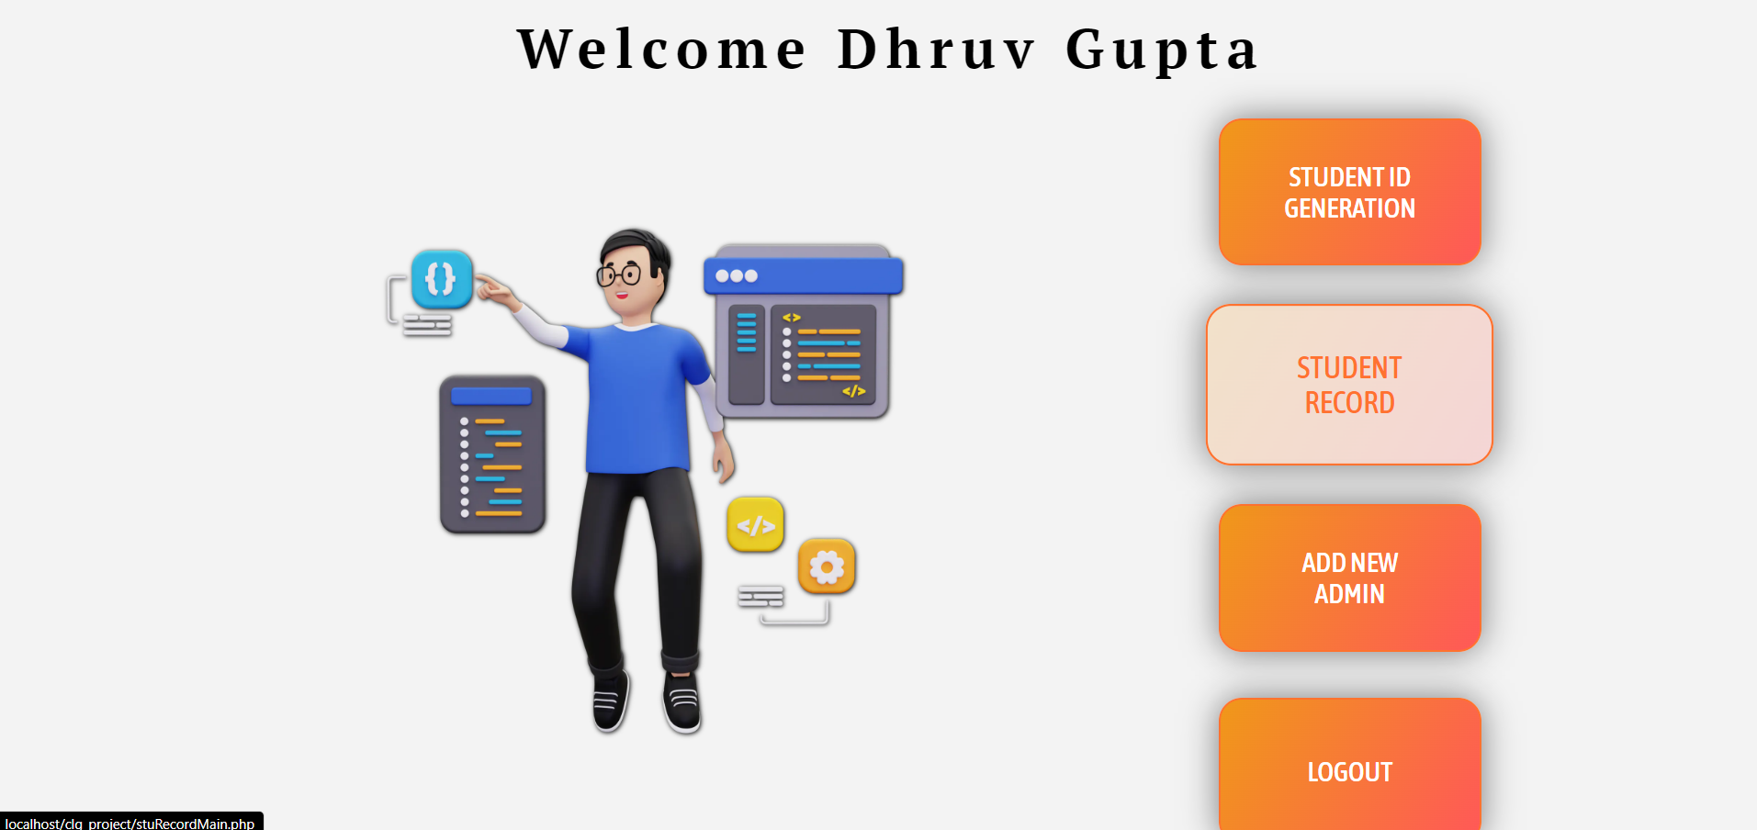
Admin Page

Slide 15
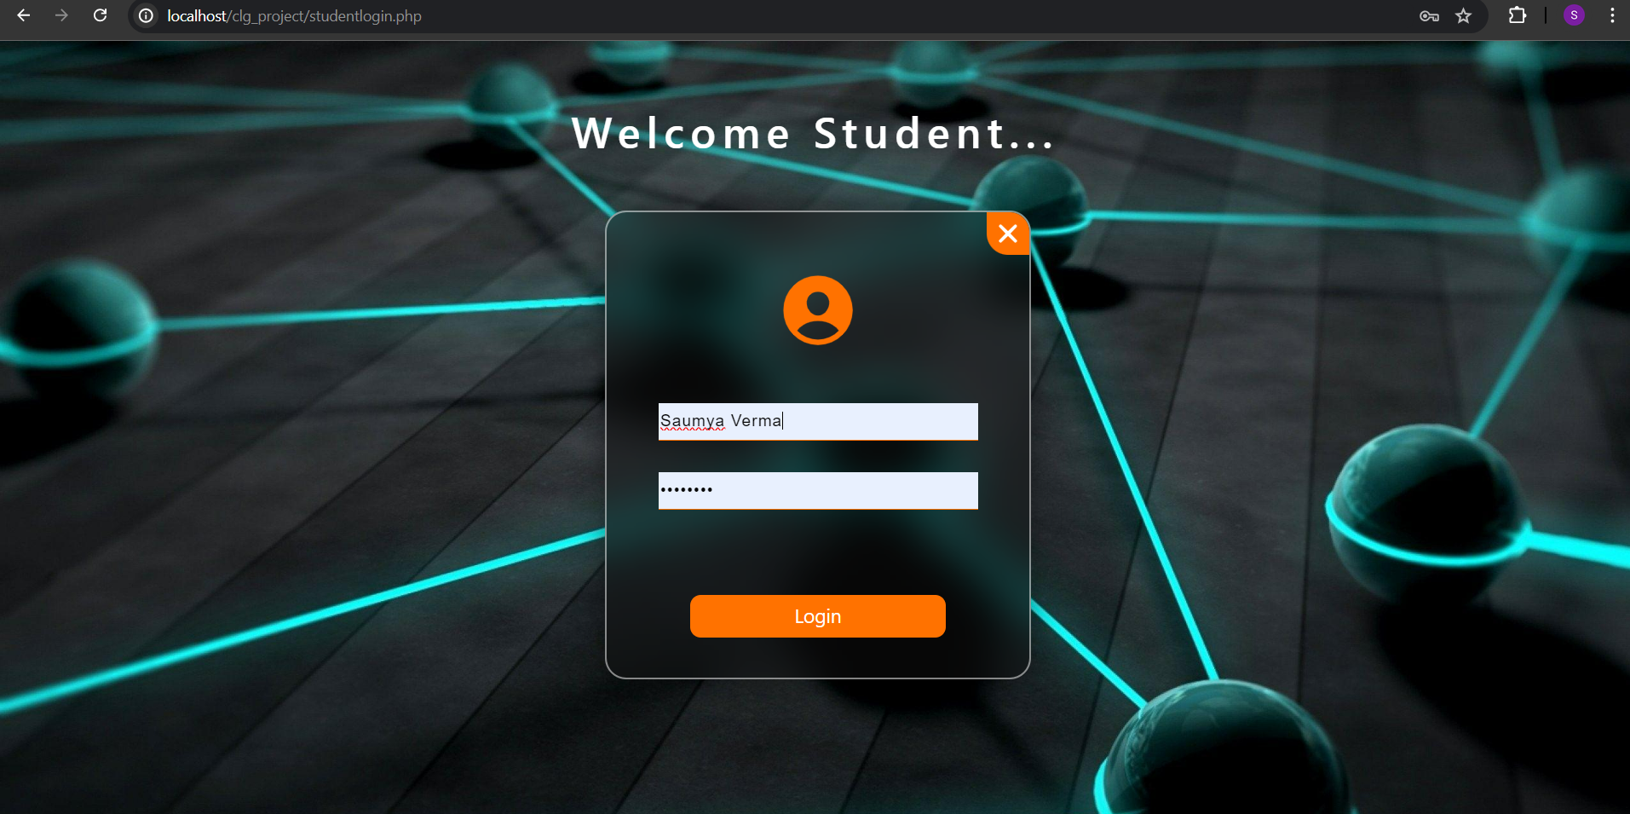
Student Login Page

Slide 16
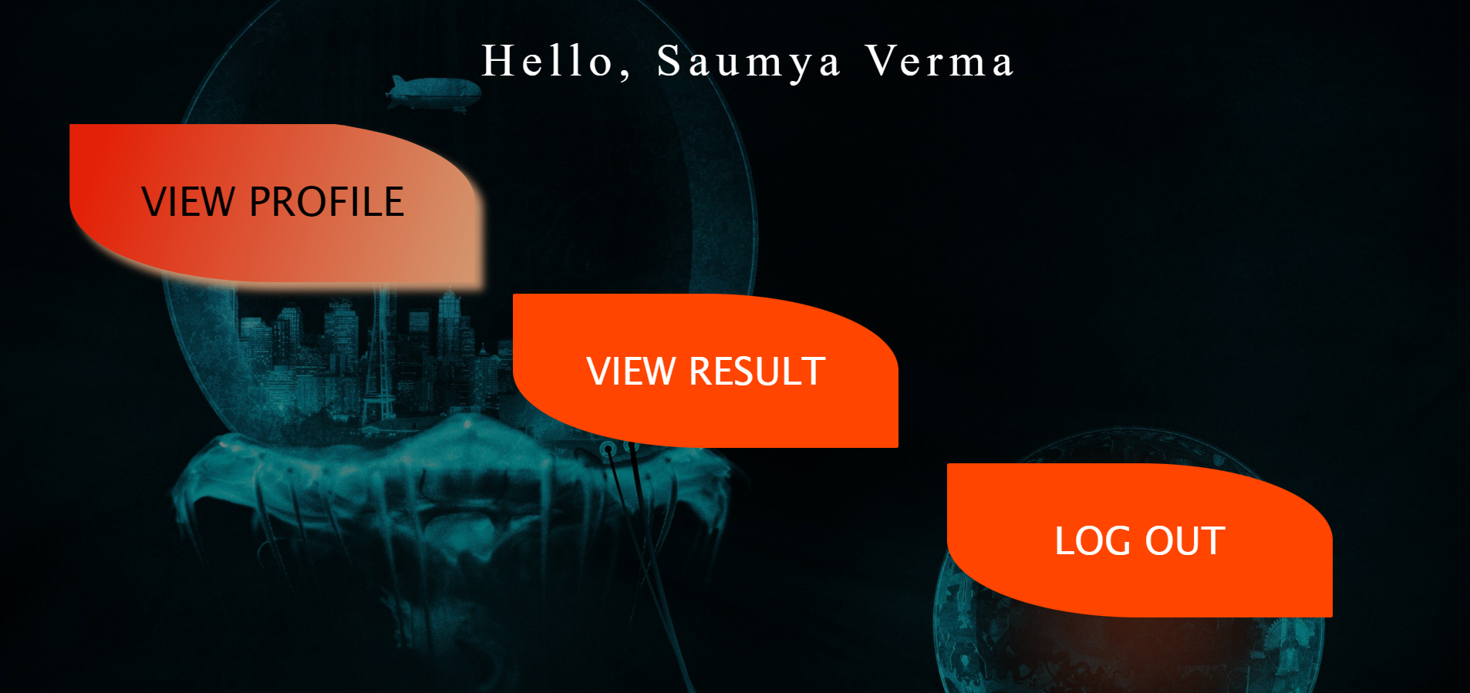
Student-Info Page

Slide 17
CONCLUSION
In summary, the website project has achieved significant milestones by creating a centralized hub for academic resources, faculty information, and departmental updates. We have received positive feedback and constructive suggestions, which will guide future improvements. Looking ahead, we plan to incorporate additional interactive features, such as online forums and virtual classrooms, to further enrich the user experience. We are excited about the potential of this platform to continually evolve and support our department’s mission. Thank you for your time and interest..

Slide 18
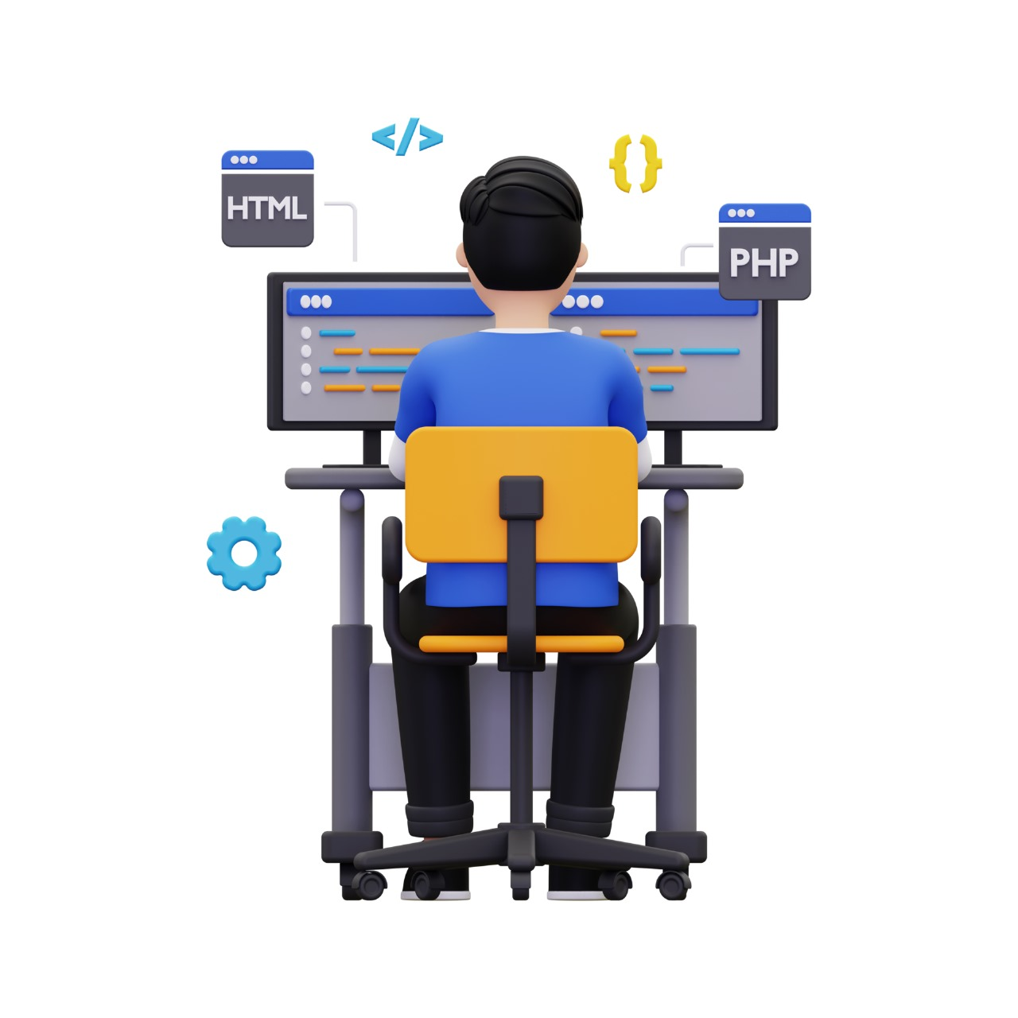
As we conclude, I’d like to reflect on the
journey of developing the Computer Science
Department Website. From
conceptualization to execution, this project
has been driven by a desire to enhance our
academic environment through technology.
The website stands as a crucial tool for our
students and faculty, facilitating better
access to information and resources. We
remain committed to its continuous
development, ensuring it grows and adapts
to meet the evolving needs of our
department. Thank you for your attention
and support in this endeavor.

Slide 19
Do you have any Question?

Slide 20
Thanks!

